Slide 1

Secure Software Architecture
Securing a Modern Web Application
Toan, Sally and Marko

Slide 2
Table of contents
01
02
Implication of Software Engineering
Secure Software Architecture
03
04
How the code run
Process of Making the Secure Web App

Slide 3

PWA
A Progressive Web App (PWA) is a web application created with web technologies that offers a native-like user experience. Users can install and use it on their devices just like any other app.
Purpose of project:
The goal of this project is to create a Progressive Web App (PWA) that functions similarly to a traditional app in a web browser. It has features like feedback submission, user authentication, and data protection through the use modern security methods.

Slide 4
Implication of Software Engineering
Social
Ethical
Purpose of Exploring Social, Ethical, Legal & Environmental Implications:
to understand the effects that actions made by software engineers have on people, society, and the environment. This guarantees the app's sustainability, responsibility, and ethics in addition to its functionality and security.
Legal
Environmental

Slide 5
Brief Definition of Web Security Vulnerability
SQL injection: SQL Injection is a type of security vulnerability that allows attackers to manipulate SQL queries by injecting malicious input into form fields or URL parameters. This can lead to unauthorized access, data leakage, or even full control over the database.
Bcrypt Hashing:
Bcrypt is a secure password hashing algorithm designed to protect stored passwords. It includes a built-in salt and is intentionally slow to mitigate brute-force attacks.
Use: Instead of storing plain text passwords, applications store a bcrypt hash to ensure password confidentiality if the database is breached.
CSRF:
CSRF is an attack that tricks a logged-in user into unknowingly executing malicious actions on a web application in which they're authenticated. It exploits the trust a site has in the user's browser.
Example: A user unknowingly clicks a link that makes a request to change their account password.
Forwarding Redirect:
A forwarding or redirect is when a web application sends users to a different page or URL after an action (e.g., login). Open redirect vulnerabilities occur if users can control the redirection target, leading to phishing or data theft.
Two Factor Authentication (2FA)
2FA is a security mechanism that requires users to provide 2 forms of identity verification
Example: known password OR app code

Slide 6

01
Secure Software Architecture

Slide 7

Implications of Software Engineering
02

Slide 8
Implications of Software Engineering
Software engineering has wide-ranging implications that extend beyond technical considerations, influencing society, ethics, the environment, and legal frameworks.
Socially, the design and architecture of software can shape how individuals interact with technology. It influences privacy, inclusion, accessibility, and user trust. For instance, poorly designed systems may exclude users with disabilities or those in low-bandwidth areas. Likewise, failure to protect personal data can damage public confidence and cause social harm.
Ethically, software engineers are expected to act with integrity, fairness, and responsibility. Ethical considerations involve avoiding harm, respecting user autonomy, preventing algorithmic bias, and ensuring transparency. Ethical software engineering also includes being aware of how software might be used for manipulation, surveillance, or exploitation.
Environmentally, software has a tangible impact on the planet. Inefficient software can lead to high energy consumption, especially when deployed at scale through data centers and cloud computing. Engineers should aim for sustainable design by optimizing code efficiency, minimizing resource usage, and selecting eco-friendly infrastructure where possible.
Legally, software systems must comply with relevant data protection and cybersecurity regulations such as the GDPR, Australia's Privacy Act, or the Cybercrime Act. Engineers must also respect intellectual property laws, including copyright and licensing agreements. Legal compliance protects users and organizations, reducing the risk of fines, data breaches, or reputational damage.

Slide 9

Process of Making the Secure Web App
03

Slide 10
Development Process and Debugging Experience
During the development of our secure web application, we initially encountered issues running the code properly, which prevented the app from functioning as expected. Fortunately, we identified the problem early in the process and made the decision to restart the project from scratch. This allowed us to rebuild the application with a clearer structure and more secure features in mind.
We began by implementing password hashing using bcrypt to ensure user credentials were stored securely. Next, we integrated CSRF protection through Flask-WTF to defend against cross-site request forgery attacks. As the project progressed, we added forwarding redirects and began implementing Two-Factor Authentication (2FA) for enhanced login security. Throughout each stage of development, bug fixing was a constant necessity. Every version of the code brought new challenges, and we regularly tested and debugged the application to ensure that it functioned correctly and securely. Although the process was difficult at times, particularly during debugging, it helped us better understand secure coding practices and reinforced the importance of thorough testing in software engineering.

Slide 11

How the code run
04

Slide 12
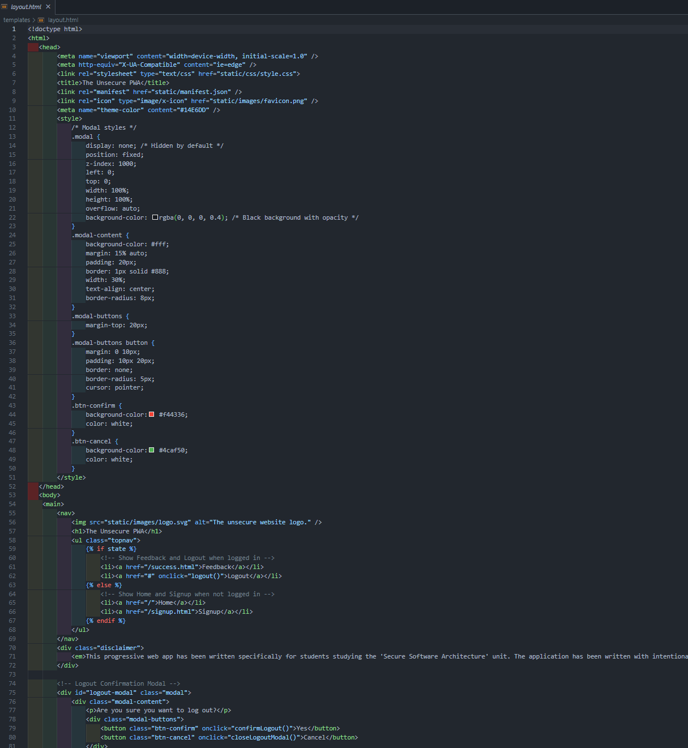
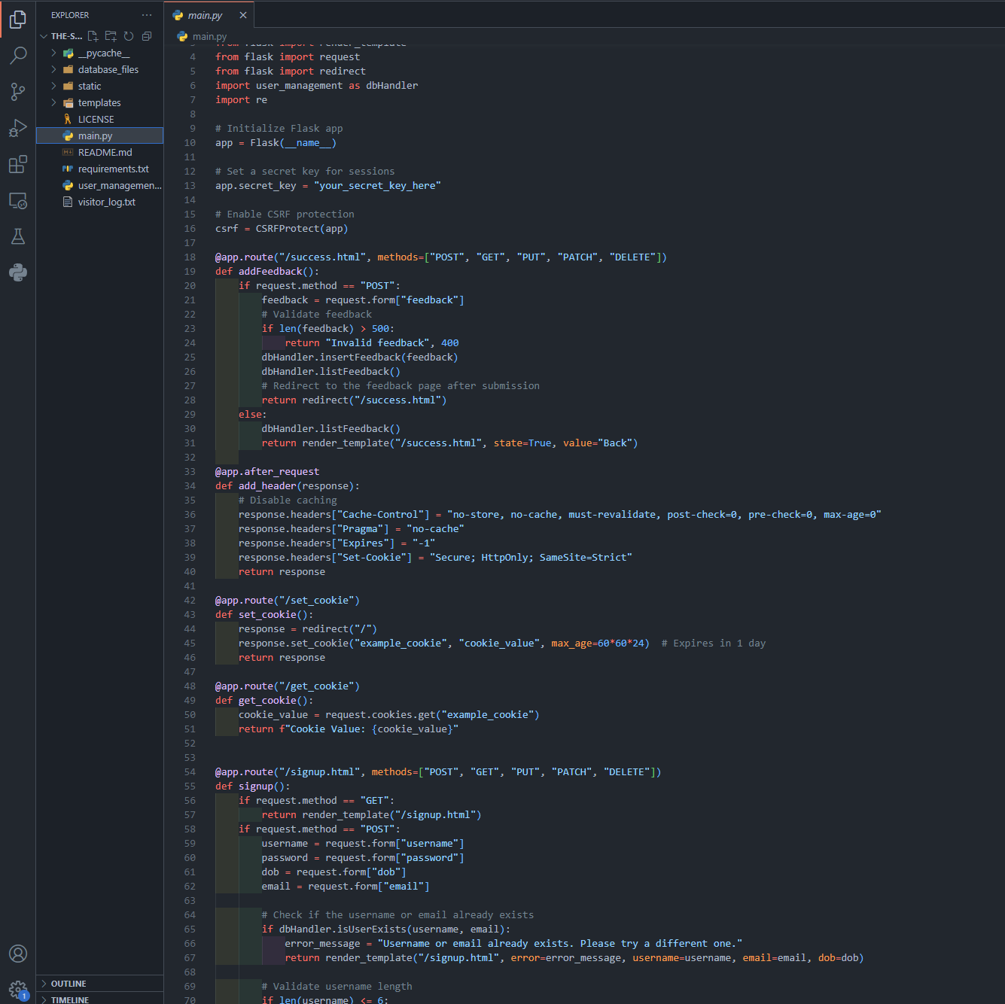
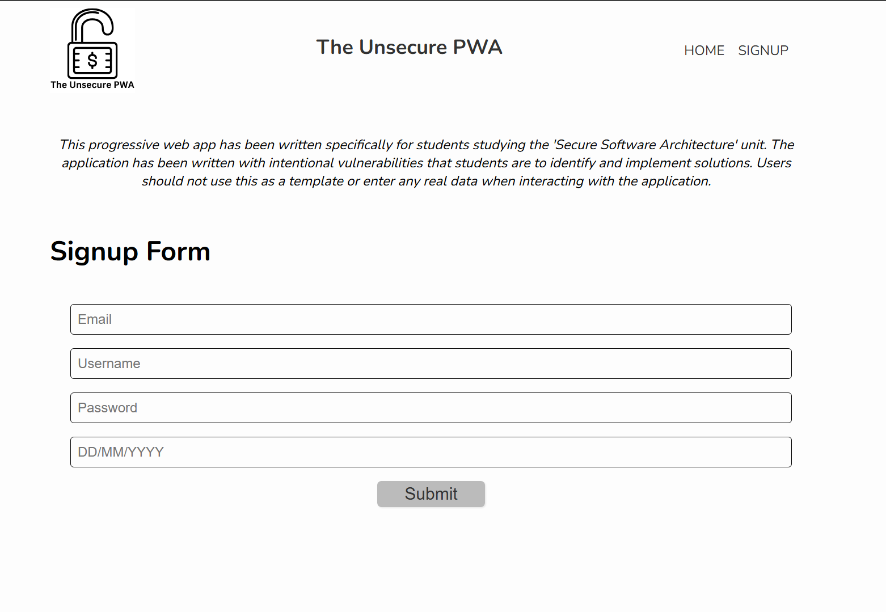
Example of Code

Slide 13

Thanks!

